Slide 1
Sample Super Store
File created on: 10/20/2023 11:23:31 PM

Slide 2
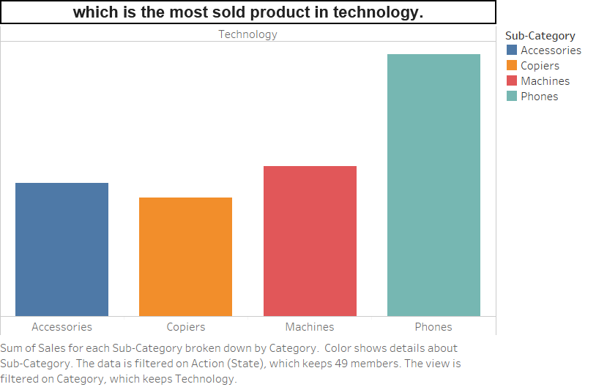

Slide 3
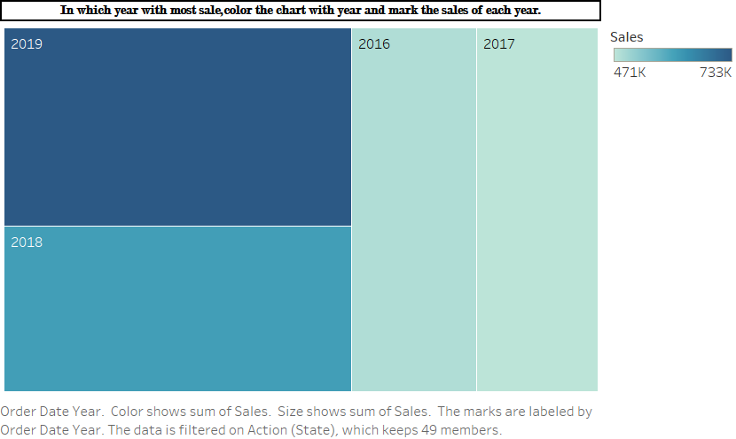

Slide 4


Slide 5
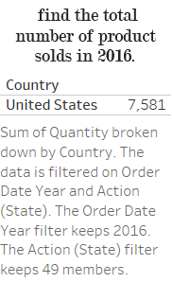

Slide 6
